Slide 1
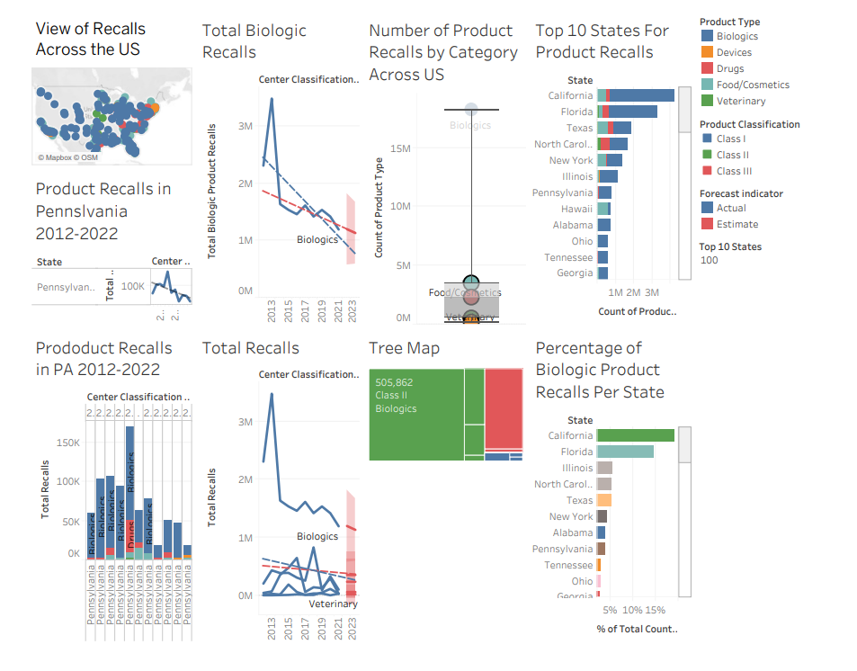
Product Recalls Presentation
Matt Chylack

Slide 2
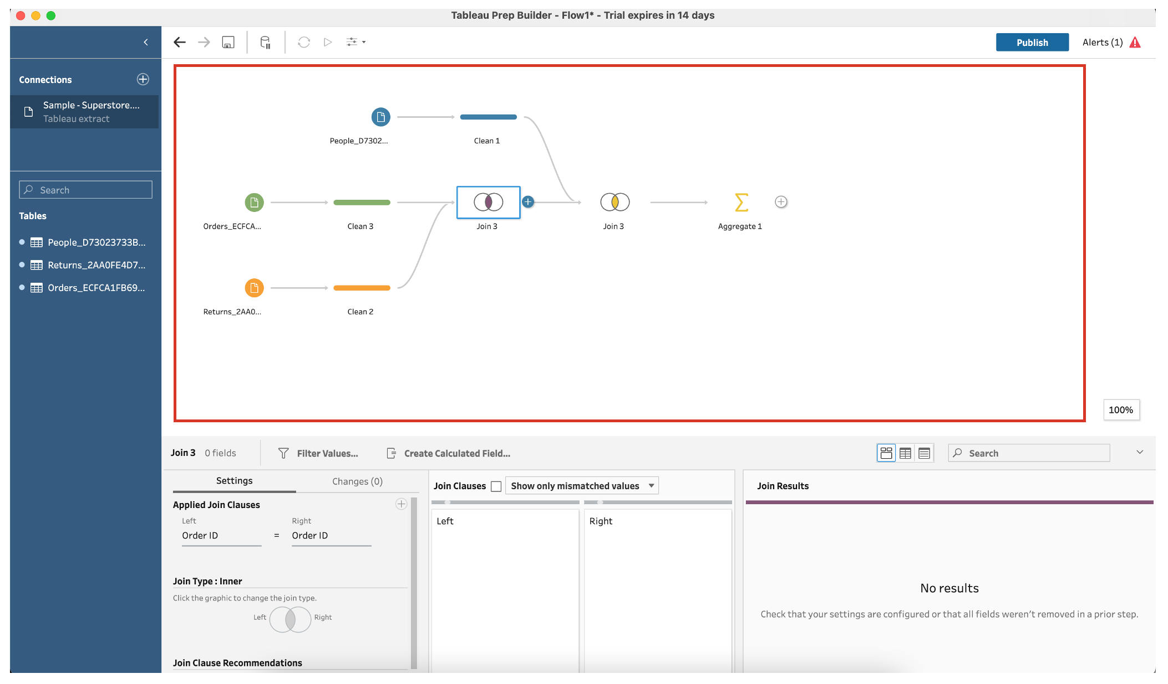
Data was found from USDA
Cleaned data using Tableau Prep builder
Completed a join with a similar dataset
Used Tableau desktop to create visualizations in a story like structure.

Slide 3
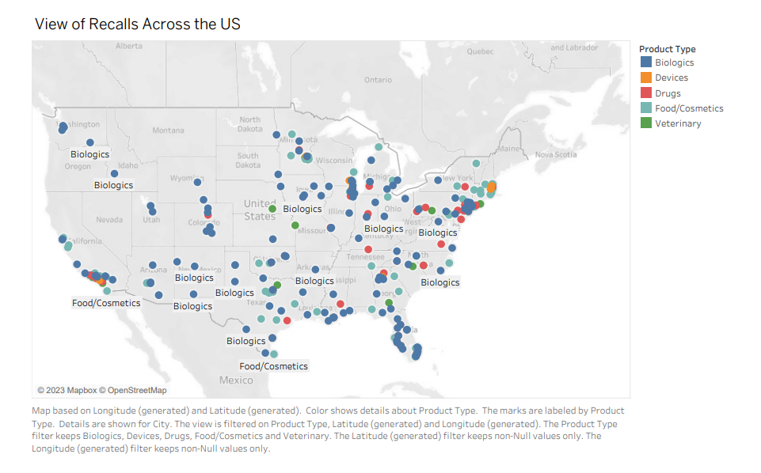
Overview of Recalls Across the US

Slide 4
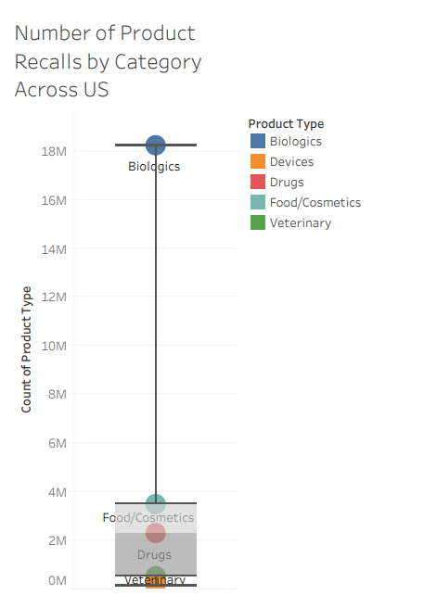
Product Recalls By Category Across the US

Slide 5
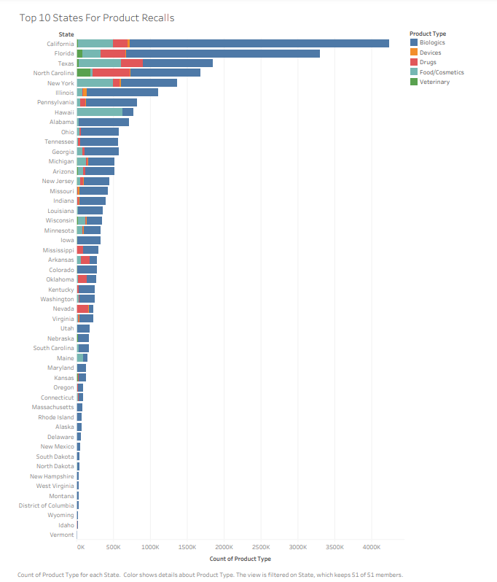

Slide 6
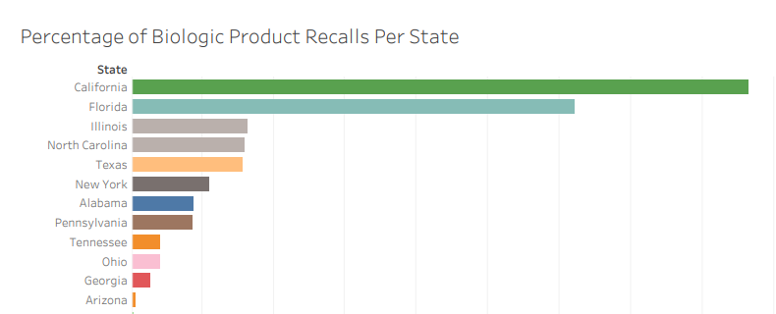

Slide 7
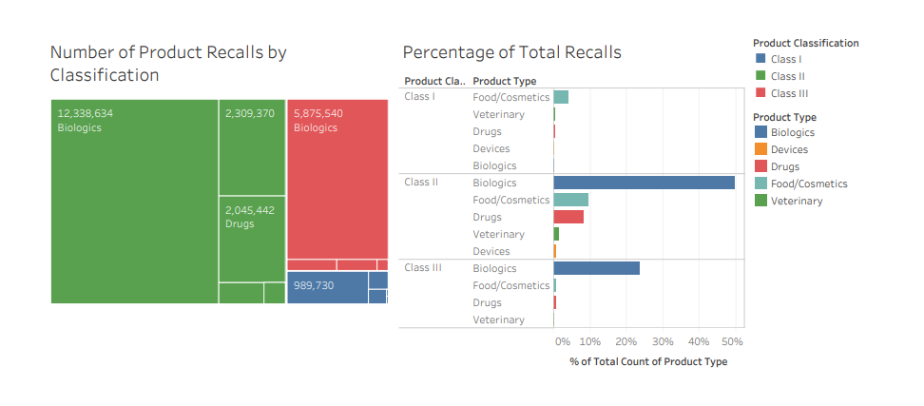

Slide 8
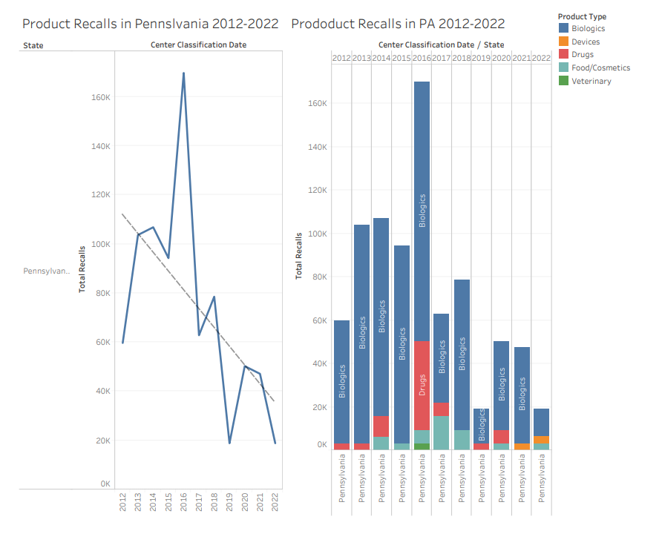

Slide 9
